Slide 1
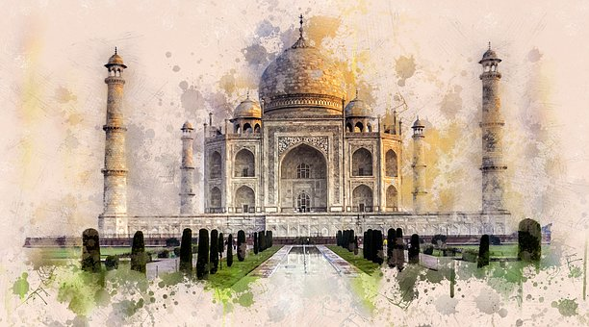
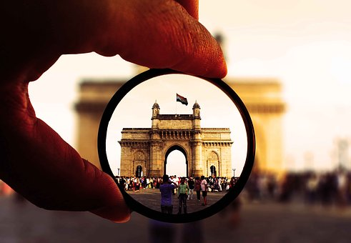
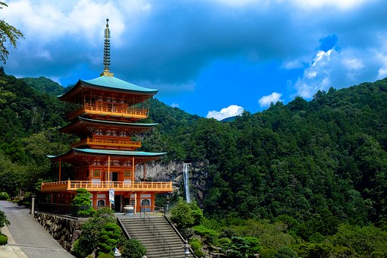

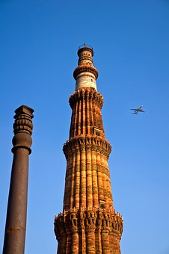
TCSへようこそ！ Welcome to TCS
Notes:
1
1

Slide 2
Customer Executives
Mr. Takashi Mineshima - Vice President & General Manager, IT Unit (Head of IT)
Mr. Kenji Toi - Vice President, Business Process Design Strategy Division
Mr. Akira Shimodaira - Vice President, Business Process Design Strategy Division
TCS Team
Pune & Mumbai
Mr. Prashant Shirgur – Business Unit Head, Enterprise Solutions Unit
Mr. Vihang Punyarthi – ESU Head, TCS Japan
Mr. Arvind Kumar – Segment Head, Manufacturing, TCS Japan
Mr. Milind Karve – Service Delivery Head & VP, JDC
Mr. Laxmikant Shaligram – Deputy Service Delivery Head & Industry Leader, MFG
Mr. Toru Kawasaki – Consulting Partner, TCS Japan
Mr. Hidetsugu Tamura – Client Partner, TCS Japan
Mr. Mahesh Gotiwale – Enterprise Architect, ESU, JDC
Ms. Meenakshi Tanksale – Solution Architect, ESU, JDC
Mr. Avinash Muley – Lead, Presales & Customer Experience
Notes:
2

Slide 3
AGENDA
Day - 1 [2nd December] – Hotel ITC Maratha
Start Time | End | Duration (Hrs) | Agenda | Location | Presenter
 | Time
18:35 | 19:30 | 1:00 | [NH829] Arrival in Mumbai and Move to ITC Maratha Hotel | Mumbai Airport
20:00 | 21:30 | 1:30 | Dinner at ITC Maratha – By TCSJ | ITC Maratha | Tamura
Day - 1 [3rd December] – Banyan Park
Start Time | End | Duration (Hrs) | Agenda | Location | Presenter
 | Time
08:30 | 09:00 | 00:30 | Hotel to Office | TCS Banyan Park
09:00 | 09:15 | 00:15 | Entry Formalities + EBC Consent forms | Block-1 Reception | Avinash
09:15 | 09:30 | 00:15 | Introduction and Agenda setting | Conf. Room | Shali + Milind + Prashant Shirgur
09:30 | 10:00 | 00:30 | Visit Expectations by Customer (Tokyo Electron Mid-term plan, expectation from TCS, TEL Vision for next 3-5 years) | Conf. Room | *TEL Members
10:00 | 11:30 | 01:30 | EBC Tour [ASML, Bridgestone, ZF, AMR Pal picker, MARS DIGITAL WORKFORCE , TAP S2P] | EBC Block | EBC presenters
11:30 | 12:30 | 1:00 | SAP Capability session & Case Studies | Conf. Room | Mahesh + Meenakshi + Prashant Shirgur
12:30 | 13:30 | 01:00 | Lunch | Sarosh Villa
13:30 | 14:00 | 0:30 | ABB Case study | Conf. Room | ABB – Chandrashekhar Ahire
14:00 | 14:30 | 0:30 | Siemens Case study | Conf. Room | Siemens- Litin Chaudhari
14:30 | 14:50 | 0:20 | Honeywell Case study | Conf. Room | Honeywell- Yogesh Dixit
14:45 | 15:00 | 0:15 | Wrap-up | Conf. Room | All
15:00 | 16:30 | 1:30 | Move to Gateway of India for Sight Seeing (See TCS House & Tata House)
16:30 | 17:15 | 0:45 | Sight Seeing Near Gateway of India
17:15 | 17:45 | 0:30 | Move to Trishna Restaurant - Seafood Specialty
17:45 | 19:30 | 1:45 | Dinner at Trishna Restaurant - Seafood Specialty |  | By TCSJ -Tamura
19:30 | 23:30 | 4:00 | Travel to Courtyard Mariott, Pune & Check-in
Notes:
3

Slide 4
AGENDA
Day - 2 [4th December] - Sahyadri Park
Start Time | End | Duration (Hrs) | Agenda | Location | Presenter
 | Time
08:30 | 09:00 | 0:30 | Hotel to Office | TCS SP
09:00 | 09:15 | 0:15 | Entry Formalities | Gate-2
09:15 | 09:30 | 0:15 | Welcome, Introduction and Agenda setting | S2 Boardroom | All
09:30 | 10:30 | 1:00 | Tech SS Capabilities and cases [ASML Case study] | S2 Boardroom | Ravi Alavandi & JOGDAND BALASAB PATIL (JB Patil)
10:30 | 11:00 | 0:30 | Japan SAP AMS session (Ebara, Kubota & Nissha etc.) | S2 Boardroom | Vihang/ Shinabe san
10:30 | 11:15 | 0:30 | MC Floor Walk [AMS Focus & S/4 Hana upgrade] | S3, 2F | Sunil Gaikwad + Sanjay Shinde
11:15 | 11:30 | 0:15 | Break | S2 Boardroom
11:30 | 12:15 | 0:45 | Service Desk Capability session [Cargill Floor walk] | S2, 7F | Avinash Shrivastava & Unmesh
12:15 | 12:45 | 0:30 | PRISM Walk through | S3 1F, PRISM ODC | Unmesh + Purva
12:45 | 13:45 | 01:00 | Lunch | S2 ECR2
13:45 | 14:30 | 0:45 | IoTDE Lab Visit – Advance electronics usage in autonomous vehicles and demos (relevance to TEL) | S1 GF | IotDE team
14:30 | 14:50 | 00:20 | Hikari Academy Walkthrough | S2 GF | Nivedita / Sagar
14:50 | 15:00 | 00:10 | Break | S2 Boardroom
15:00 | 16:30 | 1:30 | BPS Capability Session (Finance & Accounting & HR operations Session, Supply chain BPS) - Bekaert Floor walk (F&A) | S2 Boardroom | Sudha, Ganesh Sangeeta – HRO Shyamkumar Thampi – Bekaert (F&A)
16:30 | 17:30 | 1:00 | Cyber Security Session & SOC Floor walk | S2 Boardroom + S2 7F | Piyush + Pune SOC
17:30 | 18:00 | 00:30 | Wrap-up | S2 Boardroom | All
18:30 | 21:00 |  | Dinner at Vivanta Hotel - BTC | Vivanta – Mynt/Wink
Notes:
4

Slide 5
AGENDA
Day - 3 [ 5th December) – SP-2
Start Time | End | Duration (Hrs) | Agenda | Location | Presenter
 | Time
08:30 | 09:00 | 00:30 | Hotel to Office | TCS SP2
09:00 | 09:15 | 00:15 | Entry Formalities | Tower-1 | Avinash
9:15 | 10:15 | 0:30 | Project Status Updates? – SAP Assessment update | Tower-1, 11th Floor | Vihang / Yoshimatsu san
10:15 | 10:30 | 0:15 | JDC Floor walk for SAP accounts. (DMS) | Tower-1, 9th Floor | Shali
10:30 | 11:00 | 0:30 | JLR Case Study [ Infra & AMS] | Tower-1 | Amit Prabhudesai/ Amol Kale /Anchal Badariya
11:00 | 11:45 | 0:45 | AI COE Capability Session & Demos | Tower-1, 11th Floor | Shali/ AI COE team
11:45 | 12:15 | 0:30 | Wrap-up | Tower-1, 11th Floor | All
12:15 | 13:00 | 0:45 | Lunch | Concourse EDR
13:00 | 17:00 |  | Travel to Mumbai Airport[Food Court on the way]
Notes:
5

Slide 6


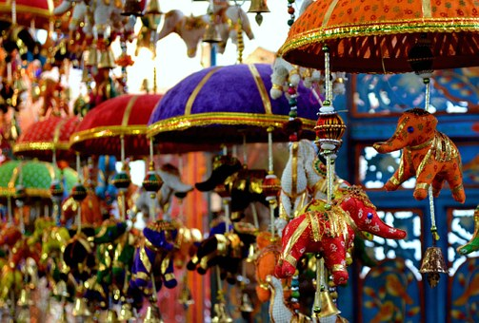
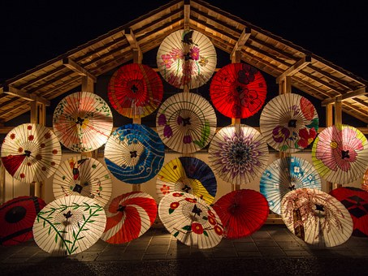


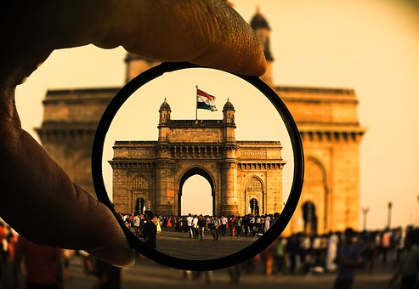
ありがとうございました

